Slide 1
Blessings House Nursing Home
Business & Financial Plan

Slide 2
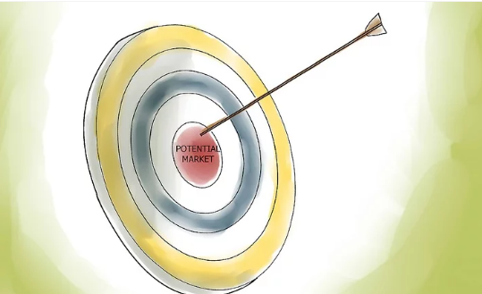
The potential markets for your business
. Customer market

Slide 3
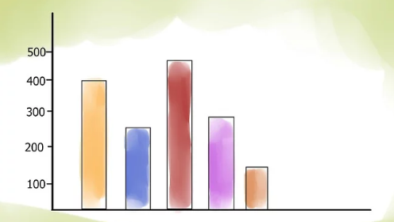
The size of your potential market
This number will create a strong basis for interpreting the target people for our products.
The targeted customers are 200

Slide 4

Company’s initial needs
Initial Financials
Start capital is $200000

Slide 5
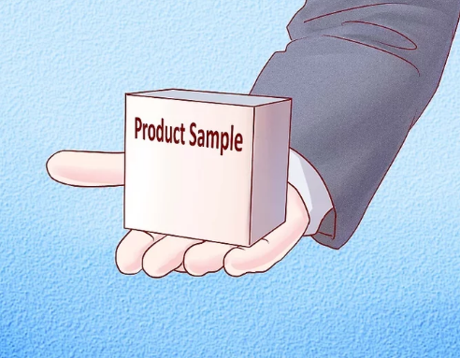
Product samples
The sample product will be patients.

Slide 6
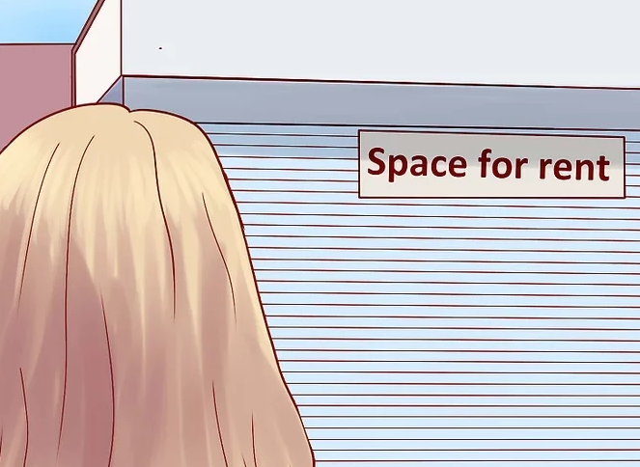
Possible locations for your business
Allocation value for rent is $1000

Slide 7

Start-up cost
Our social entrepreneurship venture, Blessings House Mobile Nursing Home has an initial capital of $500, 000.

Slide 8

Potential investment
The potential investment is $400000

Slide 9

Potential investors
Bluecarp solution $250000
Amazon $100000
Microsoft $50000

Slide 10

Define your company
Blessings House Nursing Home

Slide 11

Winning strategy
Capital strength
Local charities
A big number of nurses
Community Support
Donors.

Slide 12

Design your company
Managers
Doctors
Nurses
Subordinate staff

Slide 13

Practical issues of running a business
Integrity
Loyalty

Slide 14
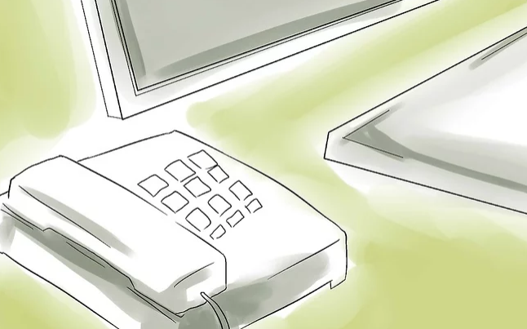
Marketing plan
Also, it is essential to note that the Blessings House Nursing Home will be like social entrepreneurship.

Slide 15

Dynamic sales effort
In a nutshell, this part of your business plan is about how you will attract customers or clients for your product or services

Slide 16

Relevant information about business
The organizational structure of Blessings House Mobile Nursing Home will have its head as the Managing Director. Under the managing director, there will be the medical director, followed by the personnel manager. The medium rank will be the doctors and the clinicians who will be the main people handling the conditions of these aged persons.

Slide 17
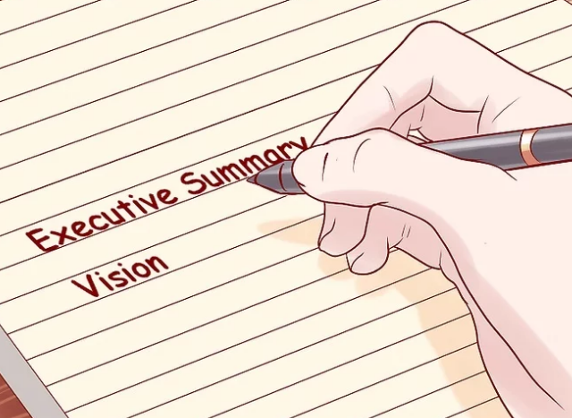
Executive summary last
It will be mobile, and it will be made available to every aged person with some of the conditions that are common with the aged people in the society.

Slide 18

All the information together
The funding model that the business will use the monthly subscription type. All the aged persons whose health will be handled by our facility will be required to make monthly subscriptions for healthcare services. Also, for those old persons who opt for the periodical visits package, they will be required to remit before the start of the package.

Slide 19

Sell yourself and your business
Lowest in the status will be the caretaking personnel who will be handling the older adults who are inpatients in the facility.

Slide 20

Financial data

